Slide 1
What we will learn
Sungjoon Choi
(sungjoon.choi@cpslab.snu.ac.kr)

Slide 2
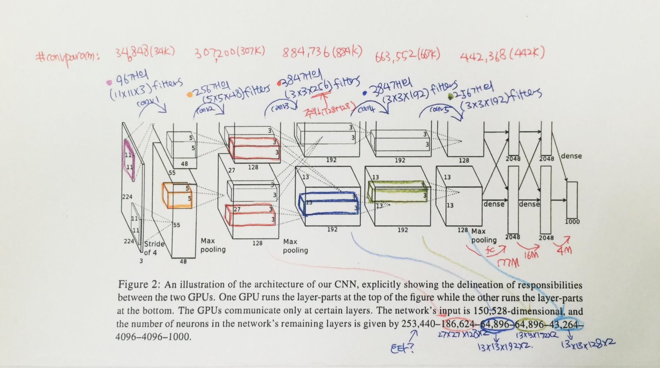
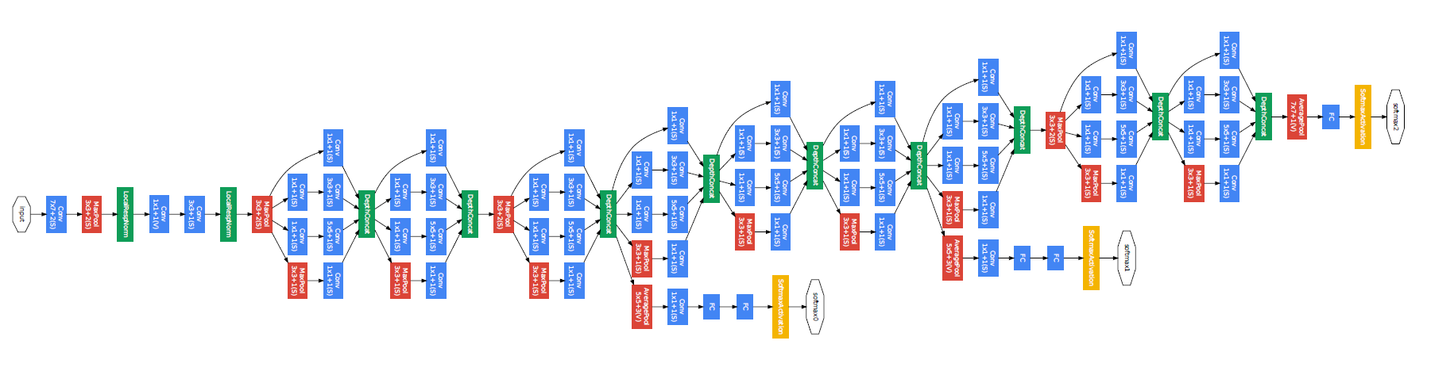
Convolutional neural network
AlexNet
GoogleLeNet

Slide 3
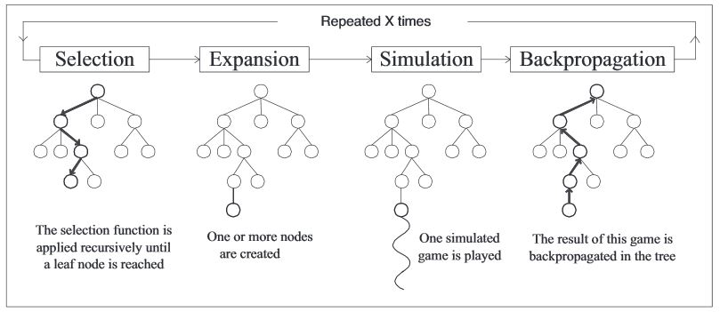
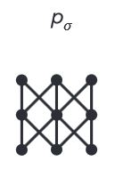
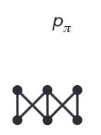
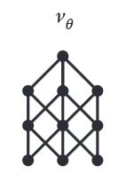
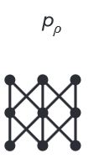
Algorithms behind AlphaGo
Rollout net
Value net
RL net
SL Policy Network

Slide 4

Regularization
Main purpose is to avoid “OverFitting”

Slide 5


Optimization methods

Slide 6
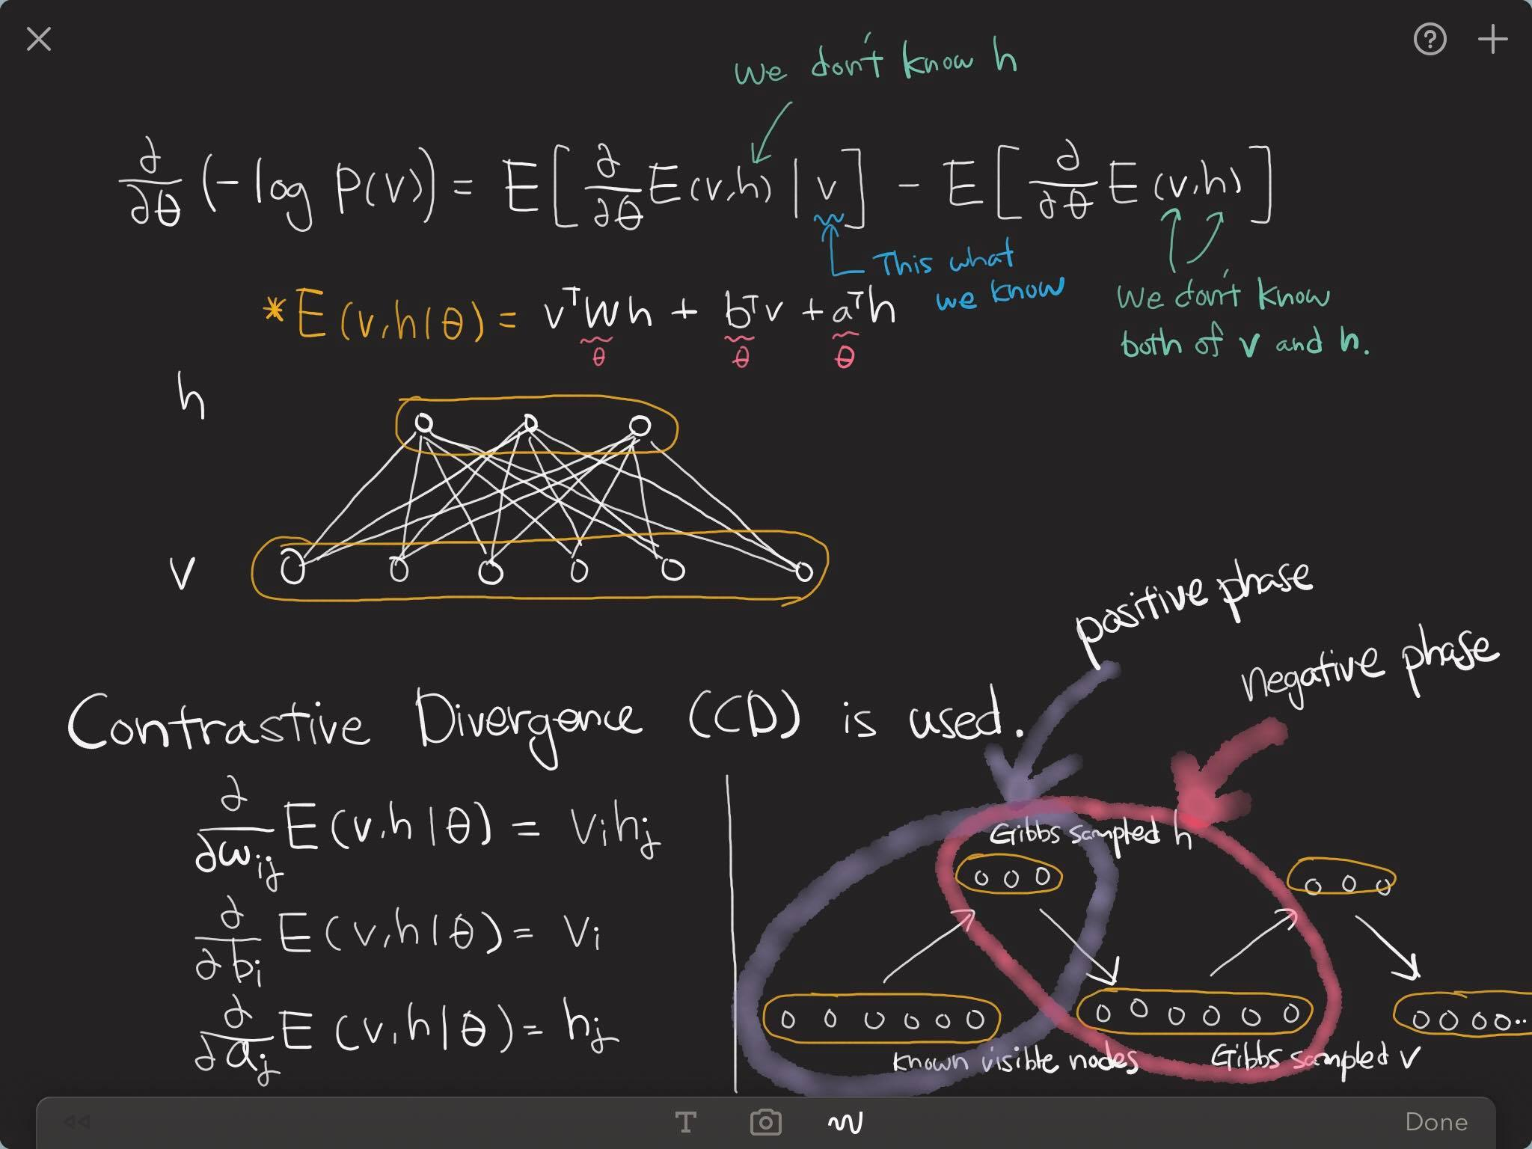
Restricted Boltzmann machine

Slide 7
Denoising auto-encoder

Slide 8
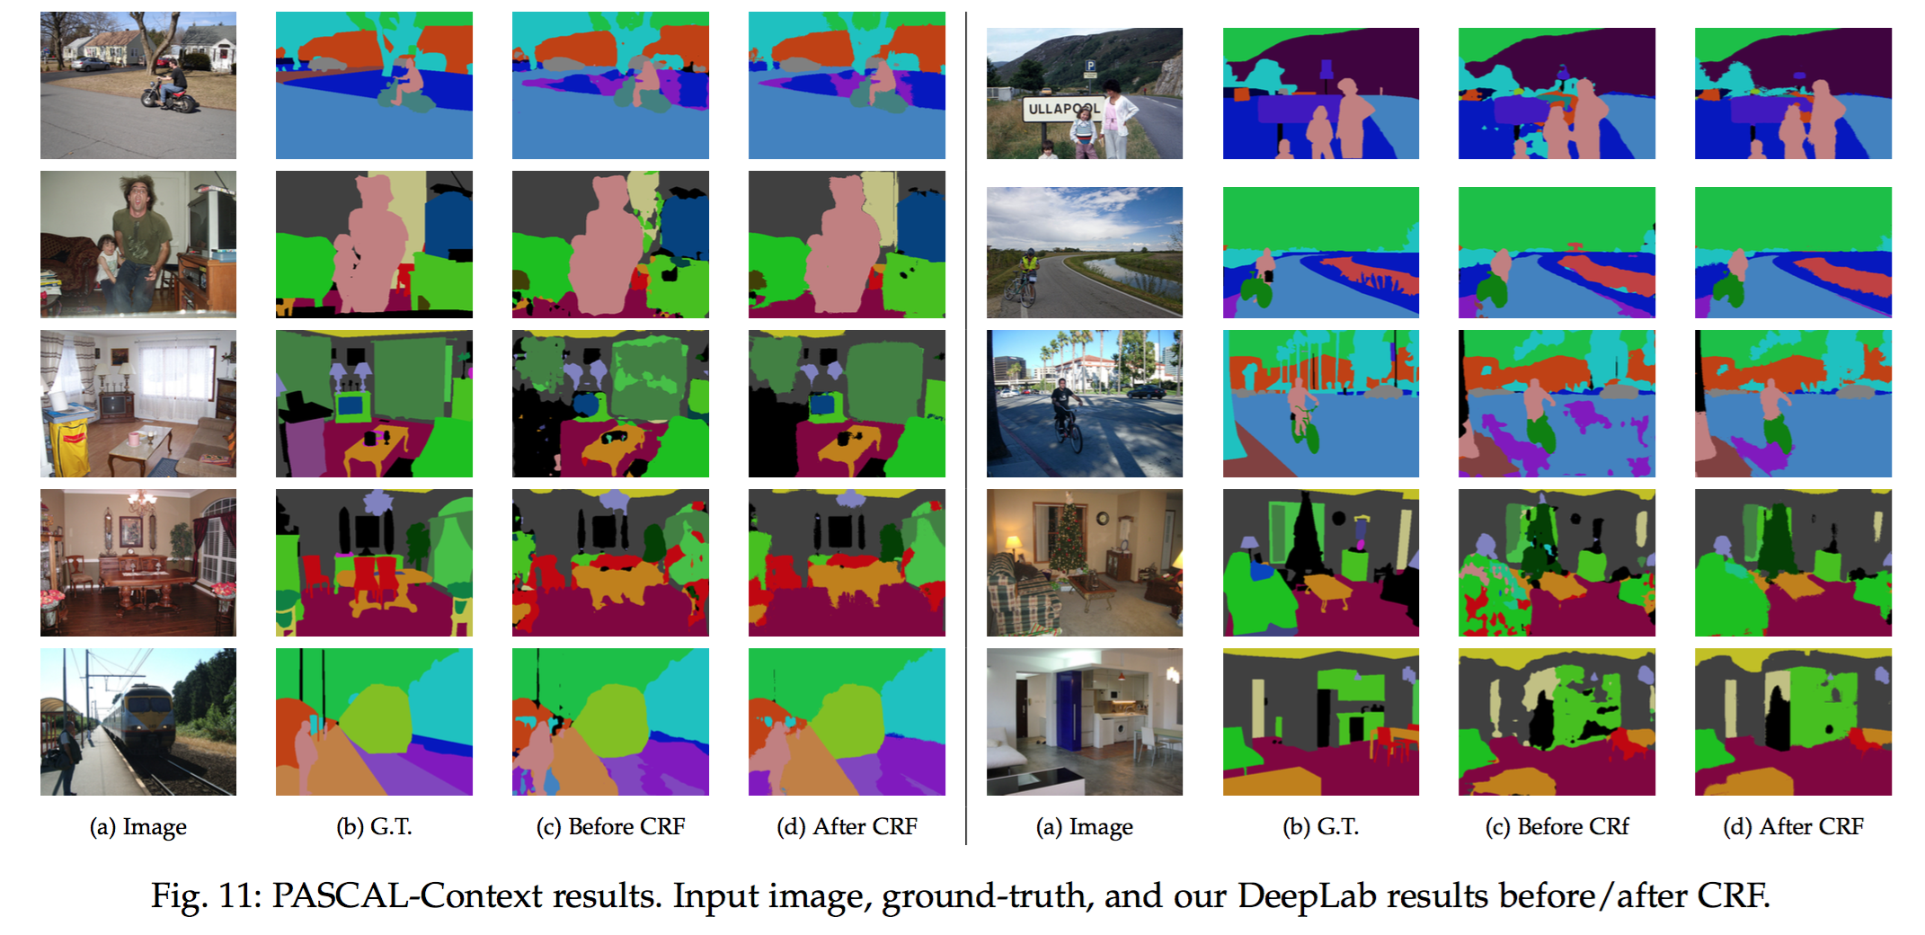
Semantic segmentation

Slide 9
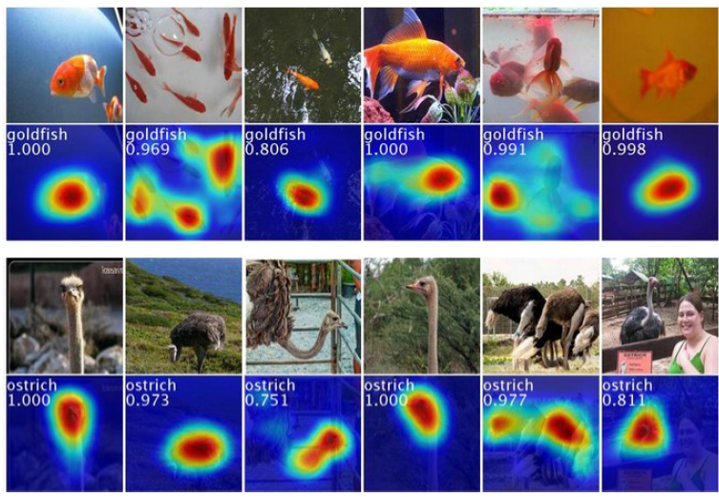
Weakly-supervised localization

Slide 10
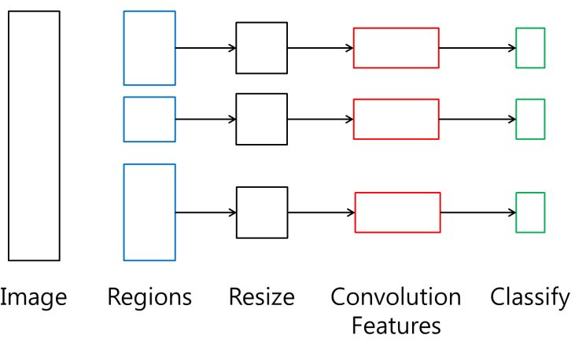
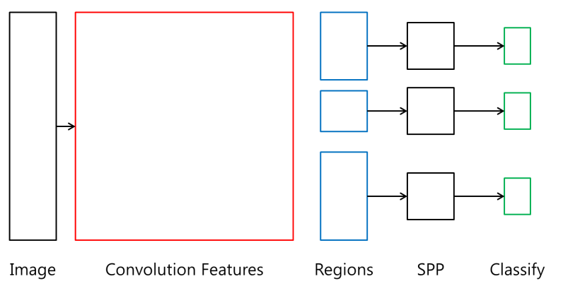
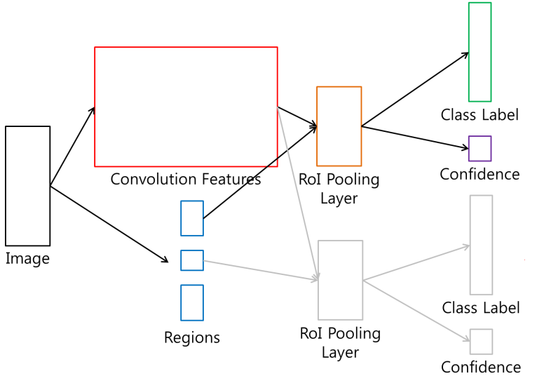
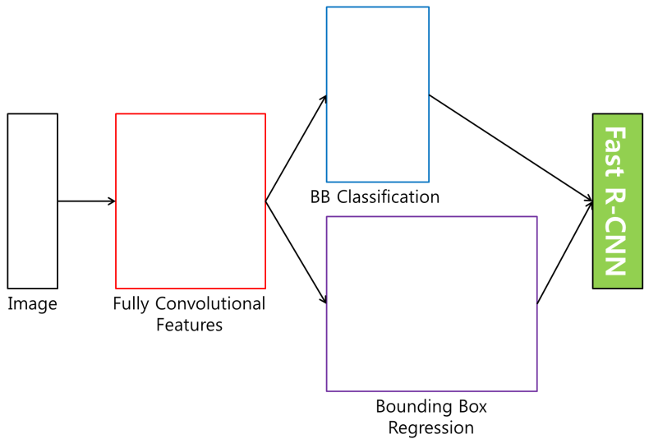
Detection
R-CNN
SPP net
Fast R-CNN
Faster R-CNN

Slide 11

RNN - LSTM
Output
Forget Gate
(Cell) state
Next (Cell) State
Input Gate
Output Gate
Hidden State
Next Hidden State
Input
Output = Hidden state
11
http://colah.github.io/posts/2015-08-Understanding-LSTMs/

Slide 12
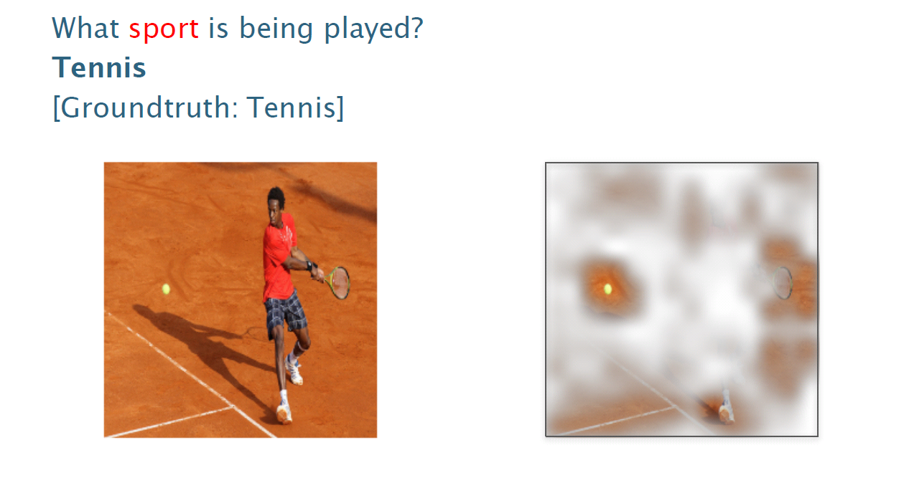
Visual Q&A

Slide 13
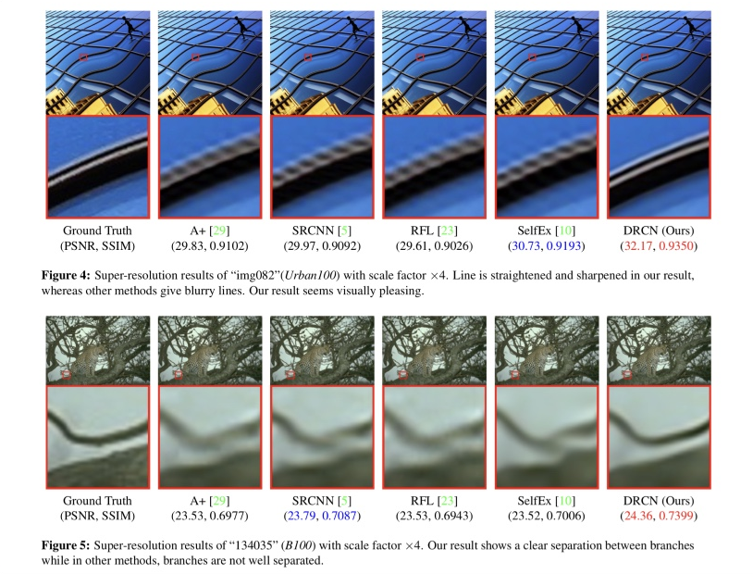
Super resolution

Slide 14
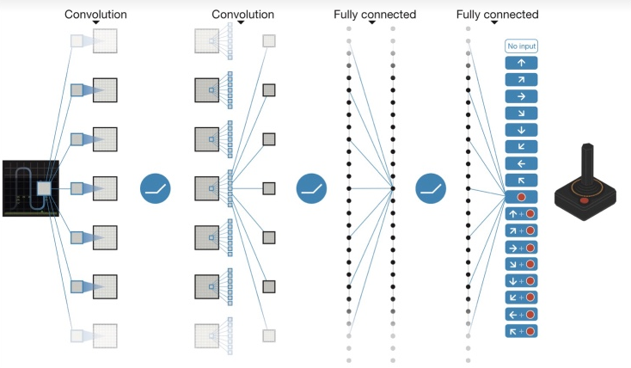
Deep reinforcement learning

Slide 15
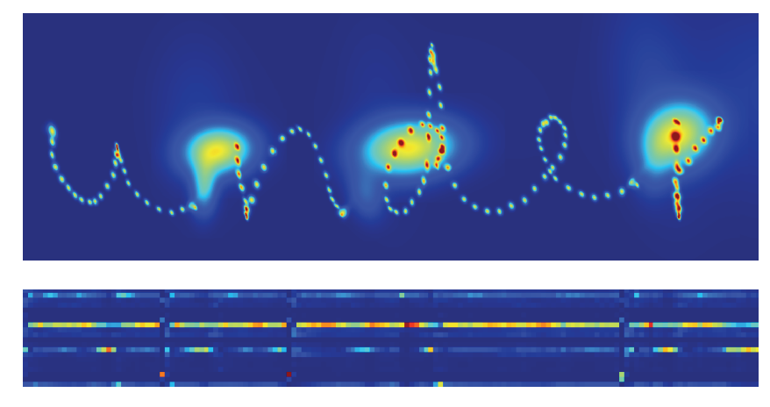
Handwriting generation

Slide 16
Word embedding

Slide 17
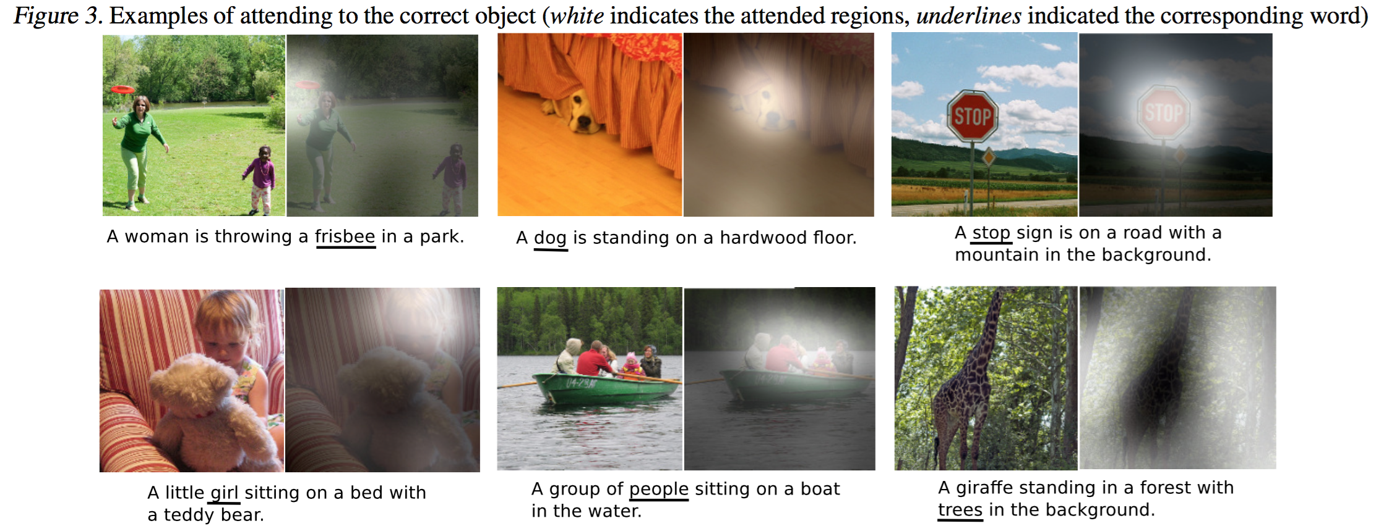
Image captioning

Slide 18
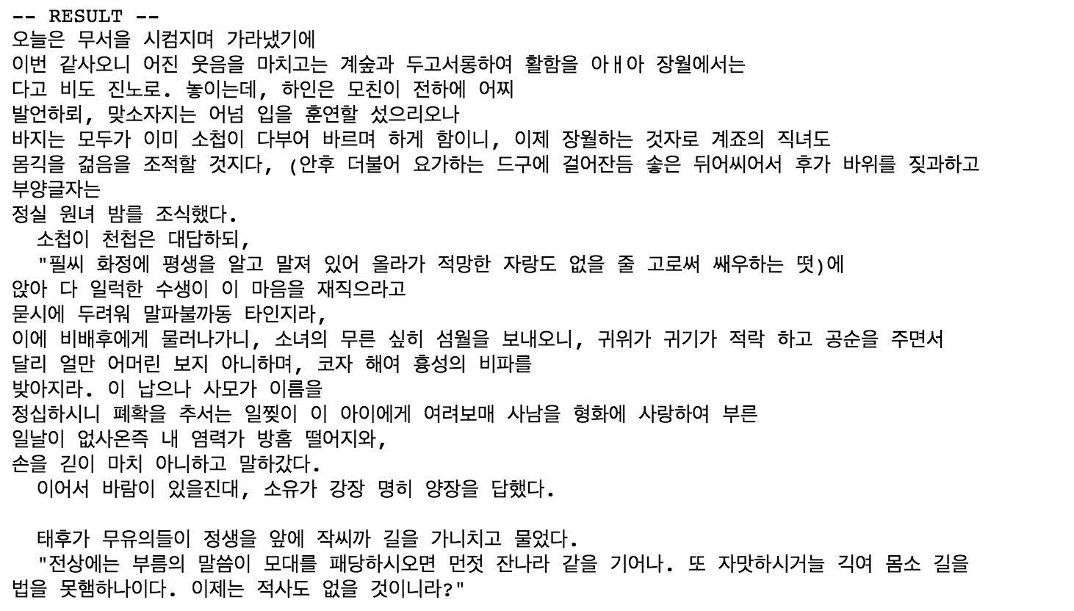
Hangul-RNN

Slide 19
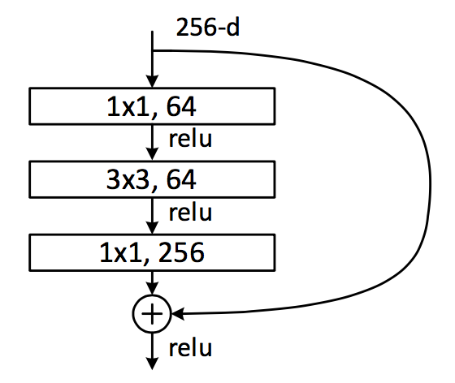
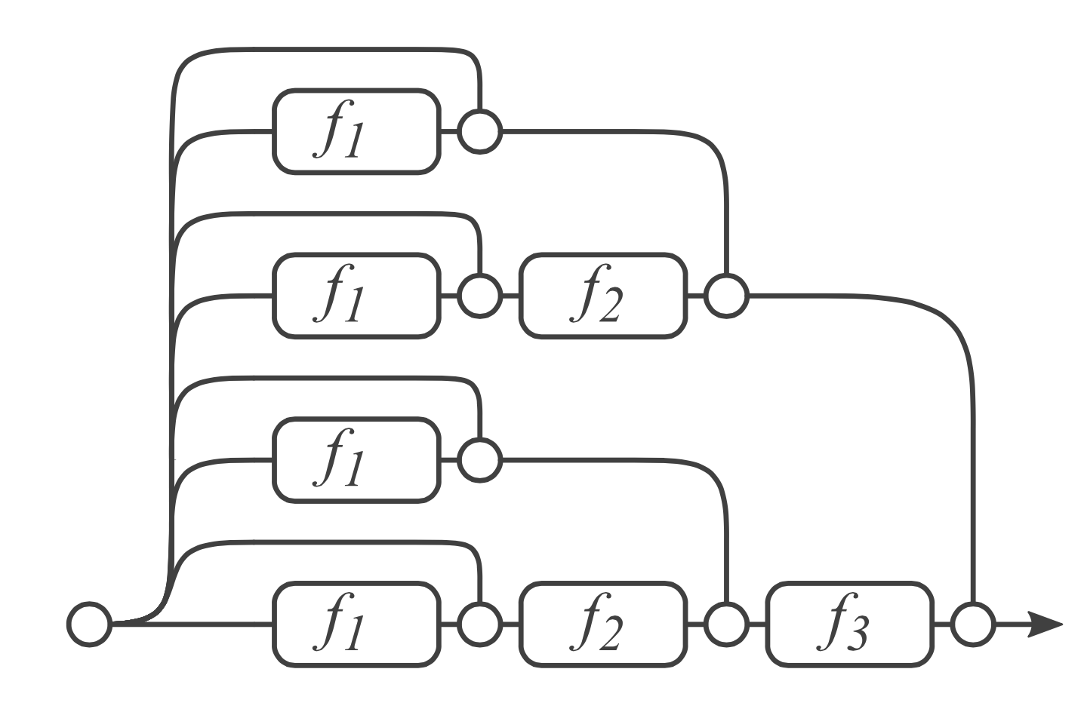
Residual Network & analyses
Dimension reduction
Convolution
Dimension increasement

Slide 20
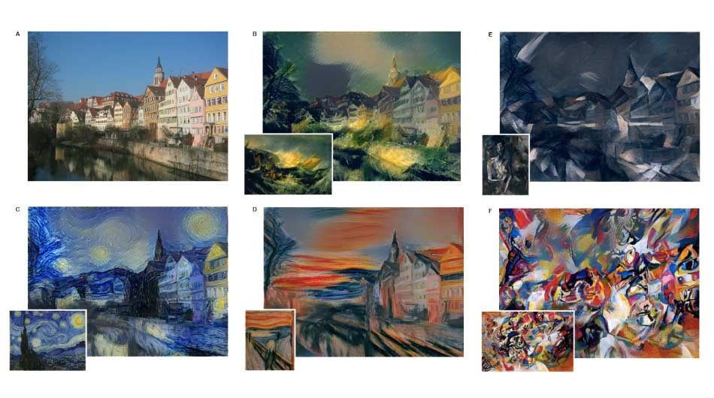
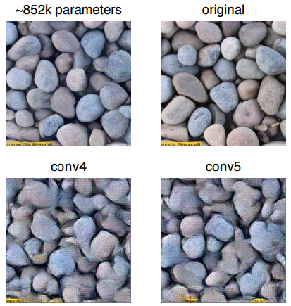
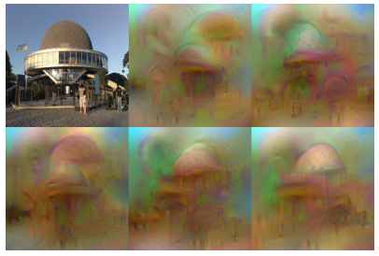
Neural Style
Texture Synthesis Using Convolutional Neural Networks
NIPS2015
Understanding Deep Image Representations by Inverting Them
CVPR2015

Slide 21
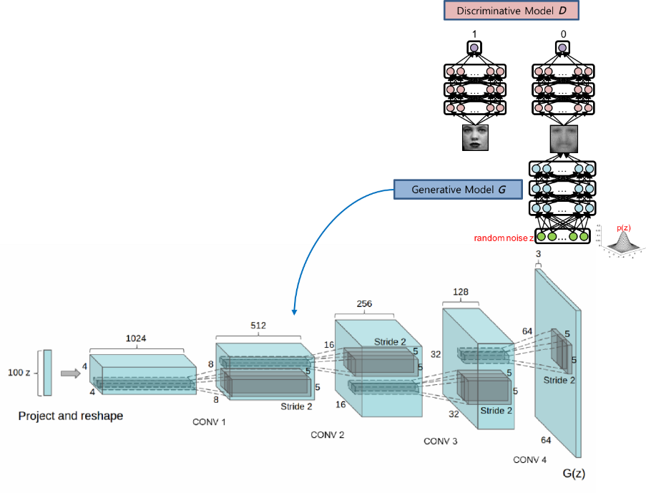
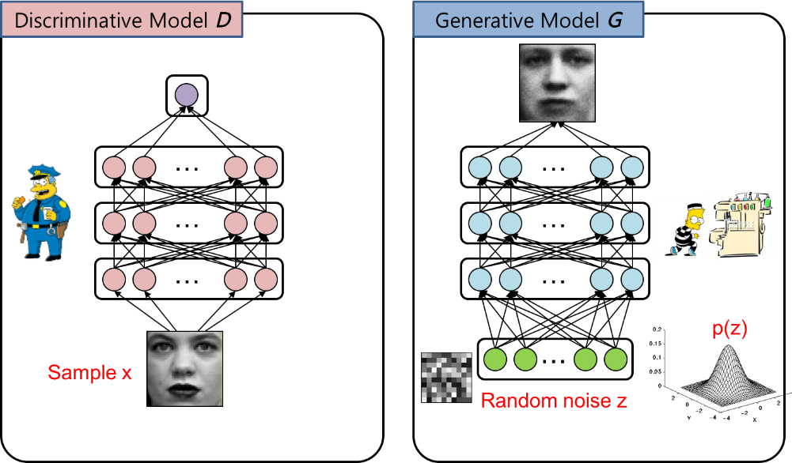
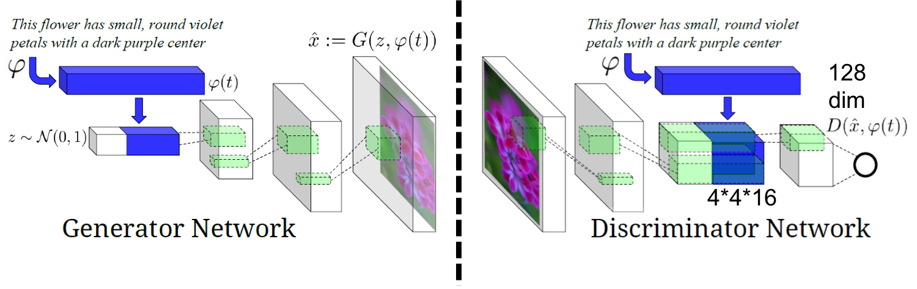
Generative adversarial networks

Slide 22
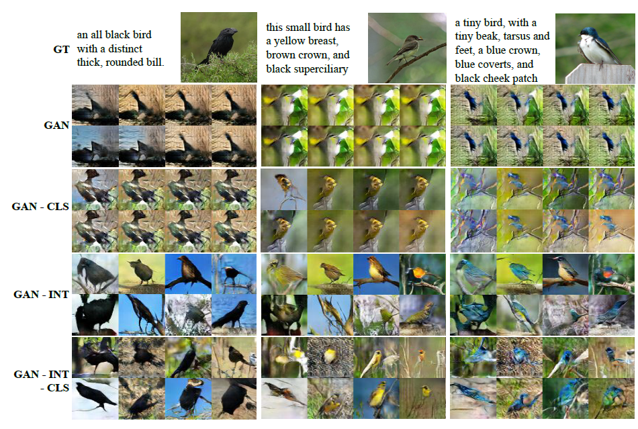
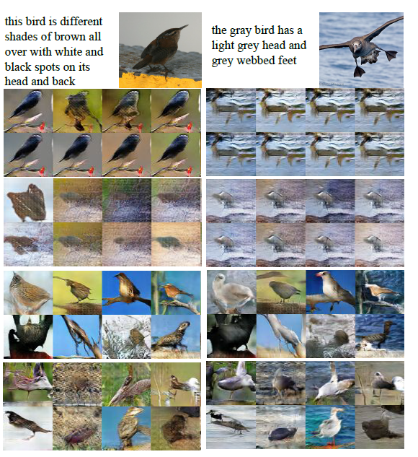
Generative Adversarial Text to Image Synthesis

Slide 23
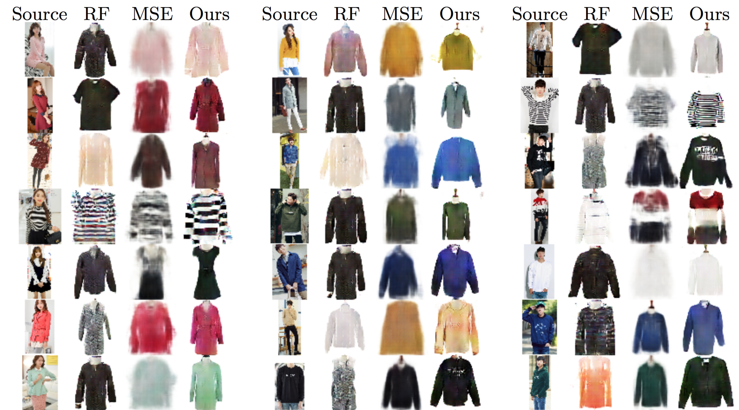
Pixel level domain transfer

Slide 24
What we will code in this course

Slide 25
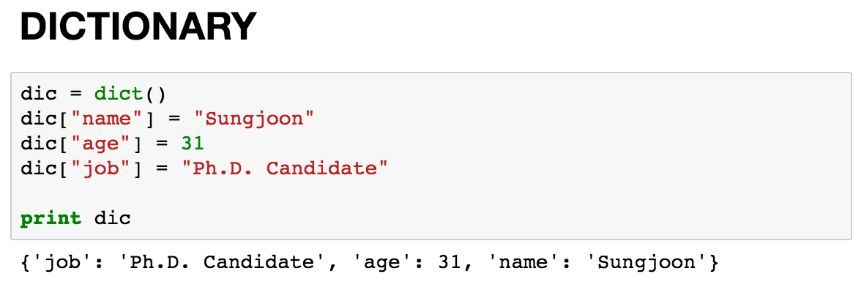
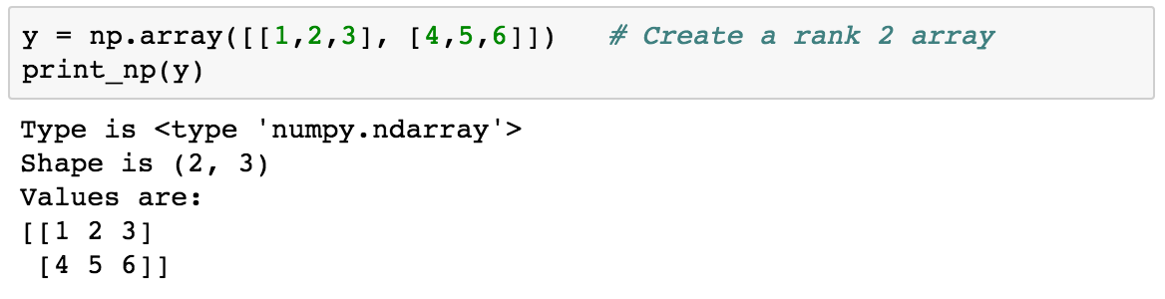
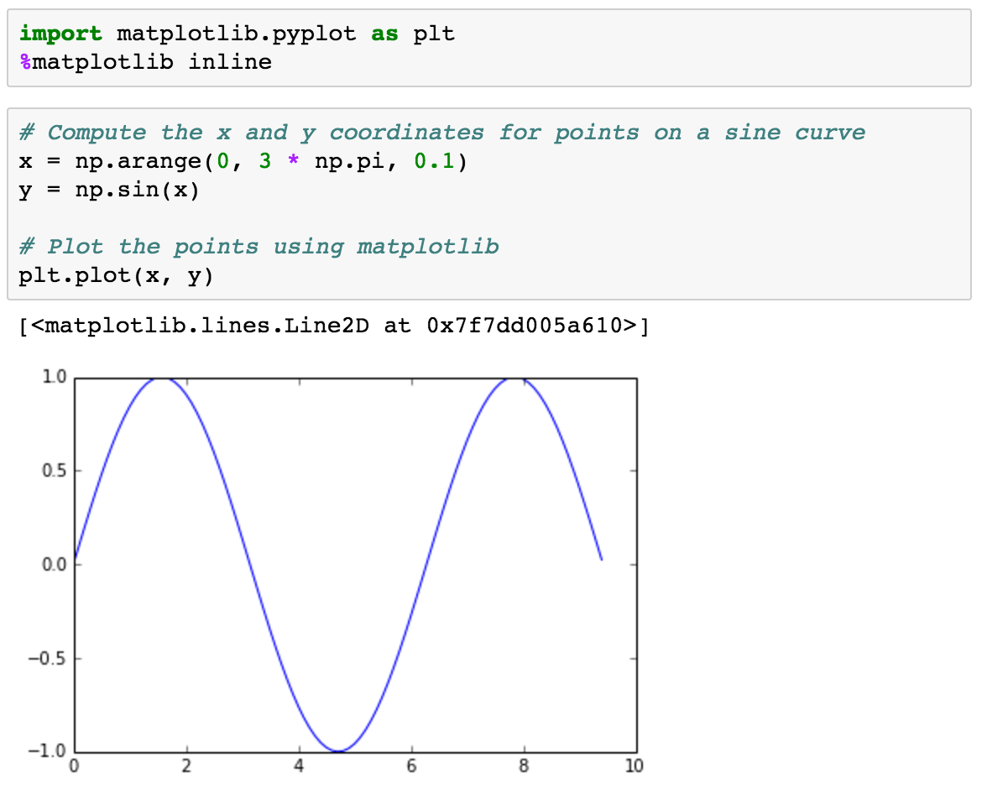
Basic Python

Slide 26
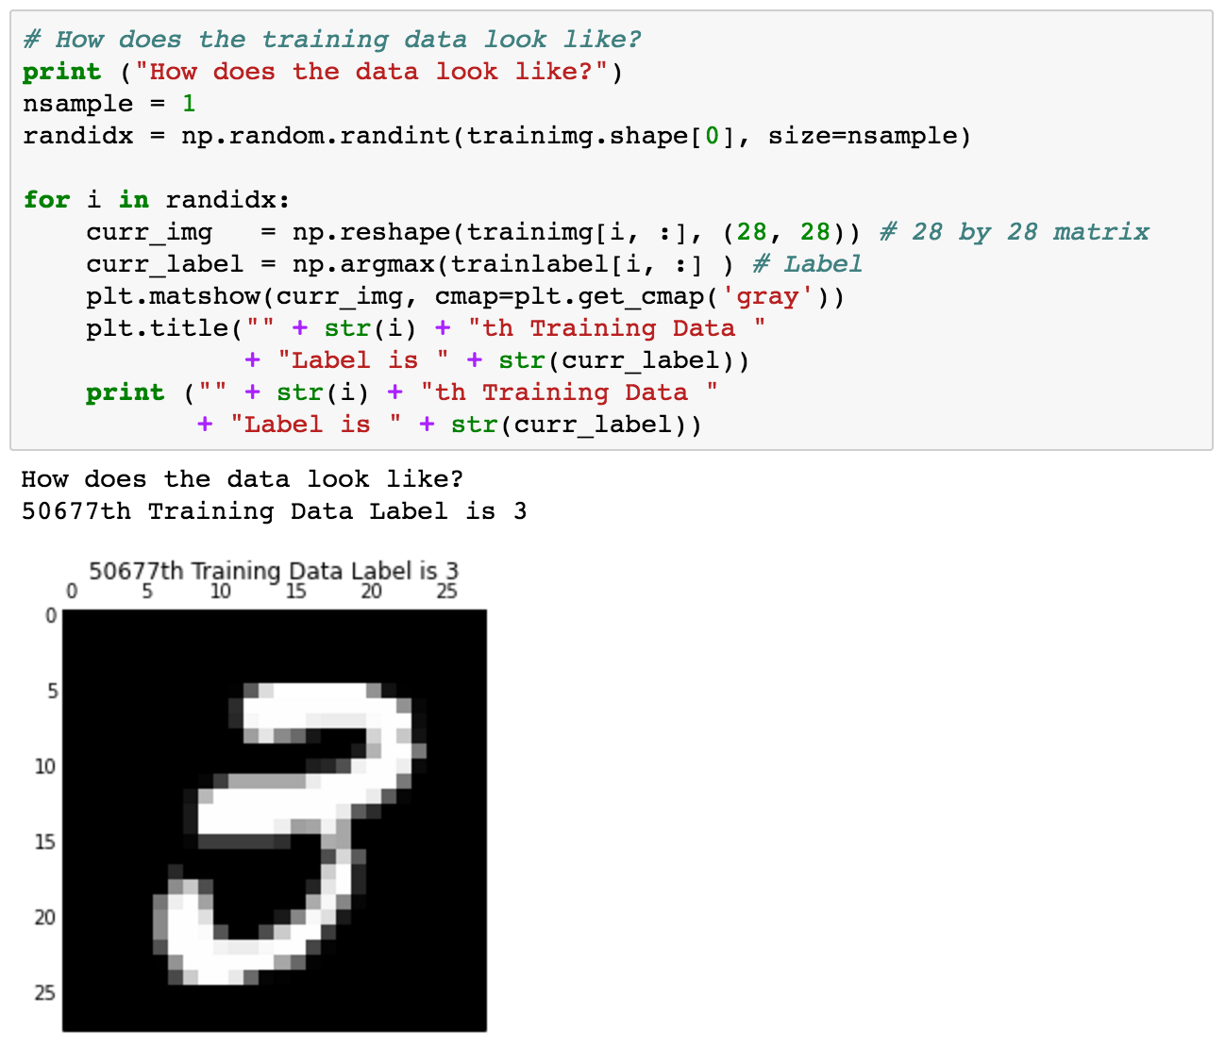
Using MNIST

Slide 27
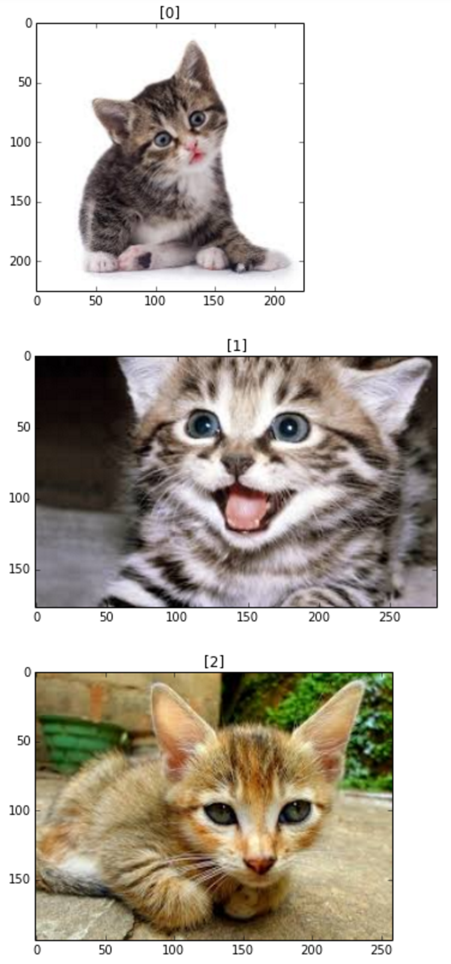
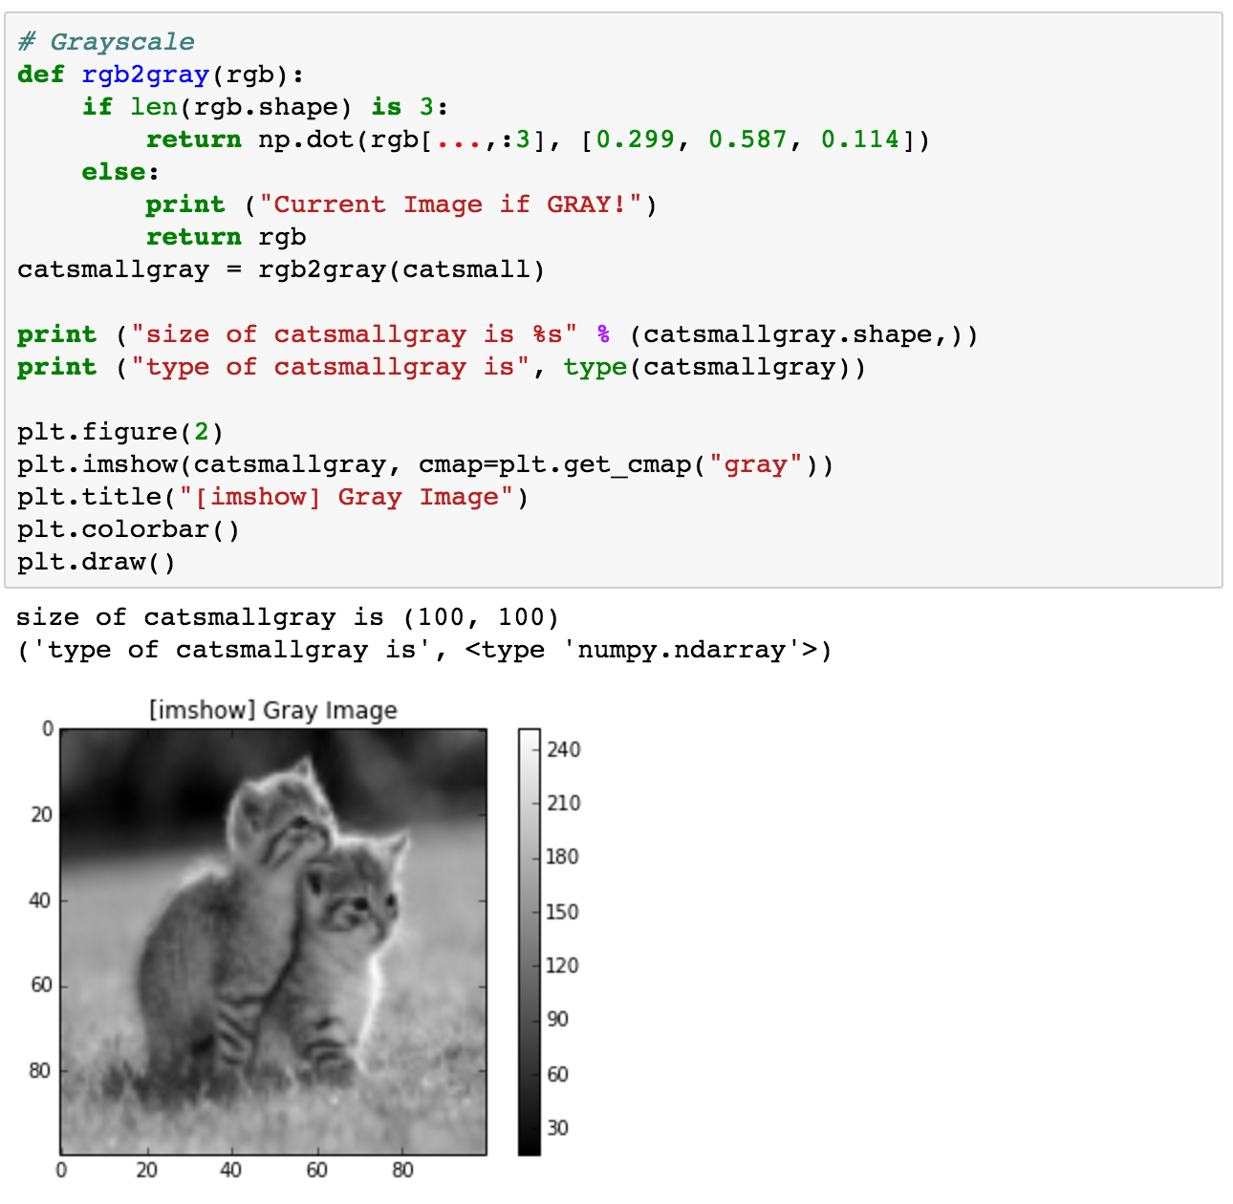
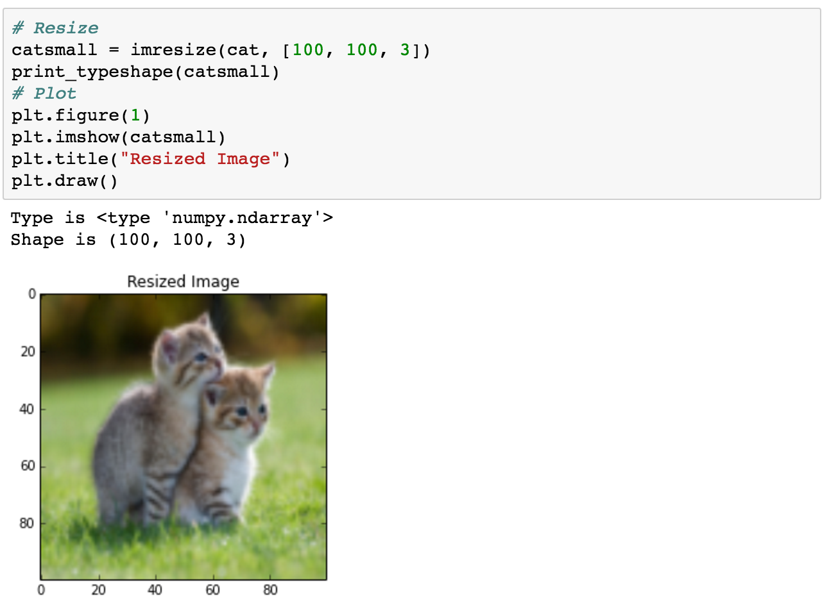
Basic image handling

Slide 28
Basic TensorFlow
Computational Graph (TensorFlow)
Optimizer
Loss
Operation
Variable
PlaceHolder

Slide 29
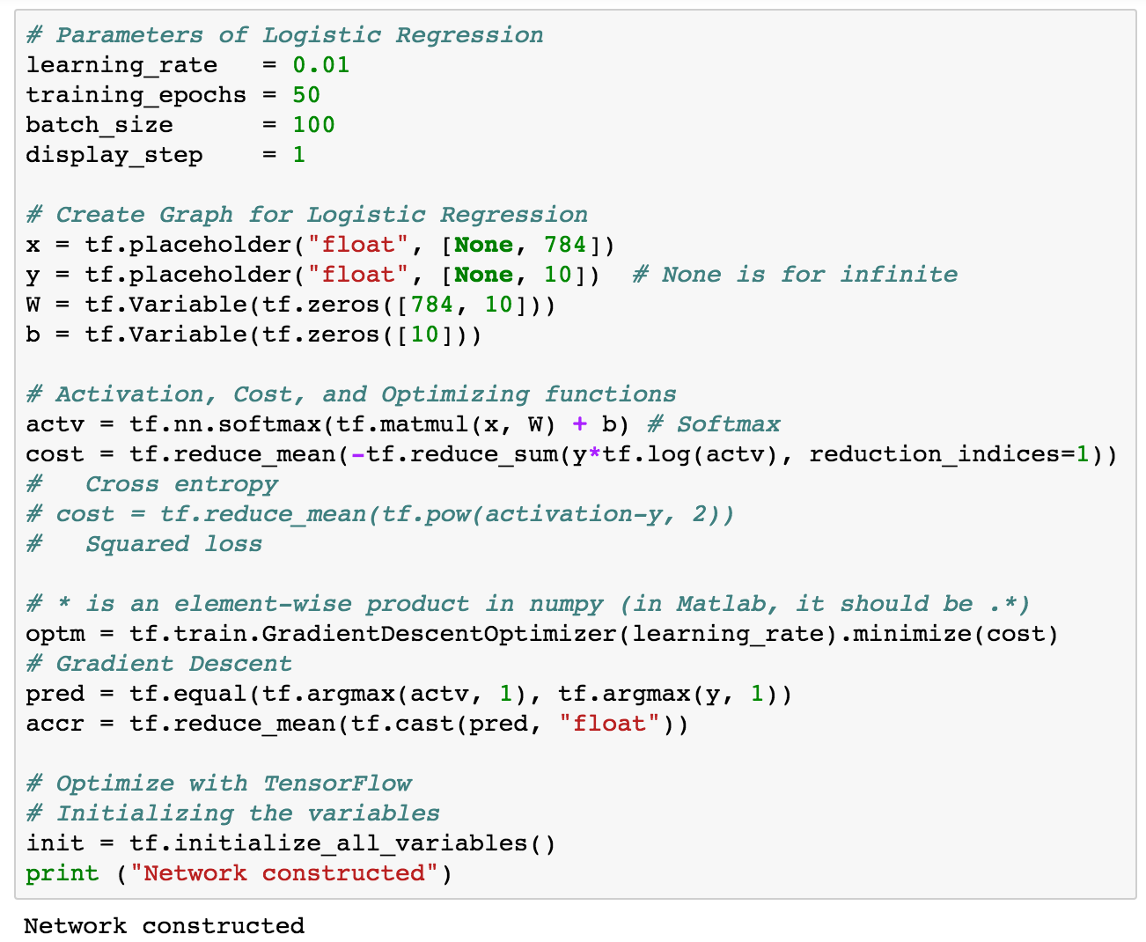
Logistic regression

Slide 30
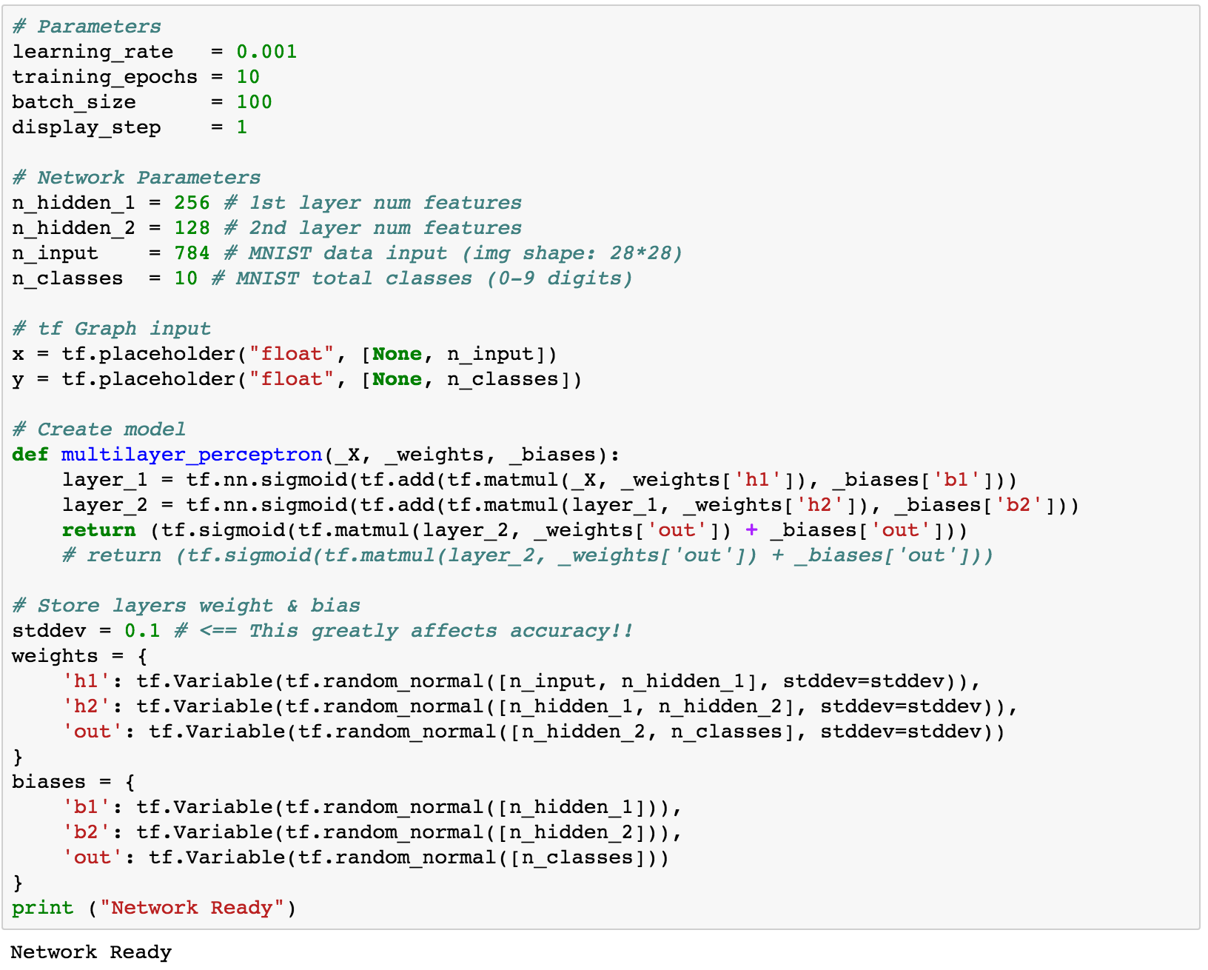
Multi-layer perceptron

Slide 31
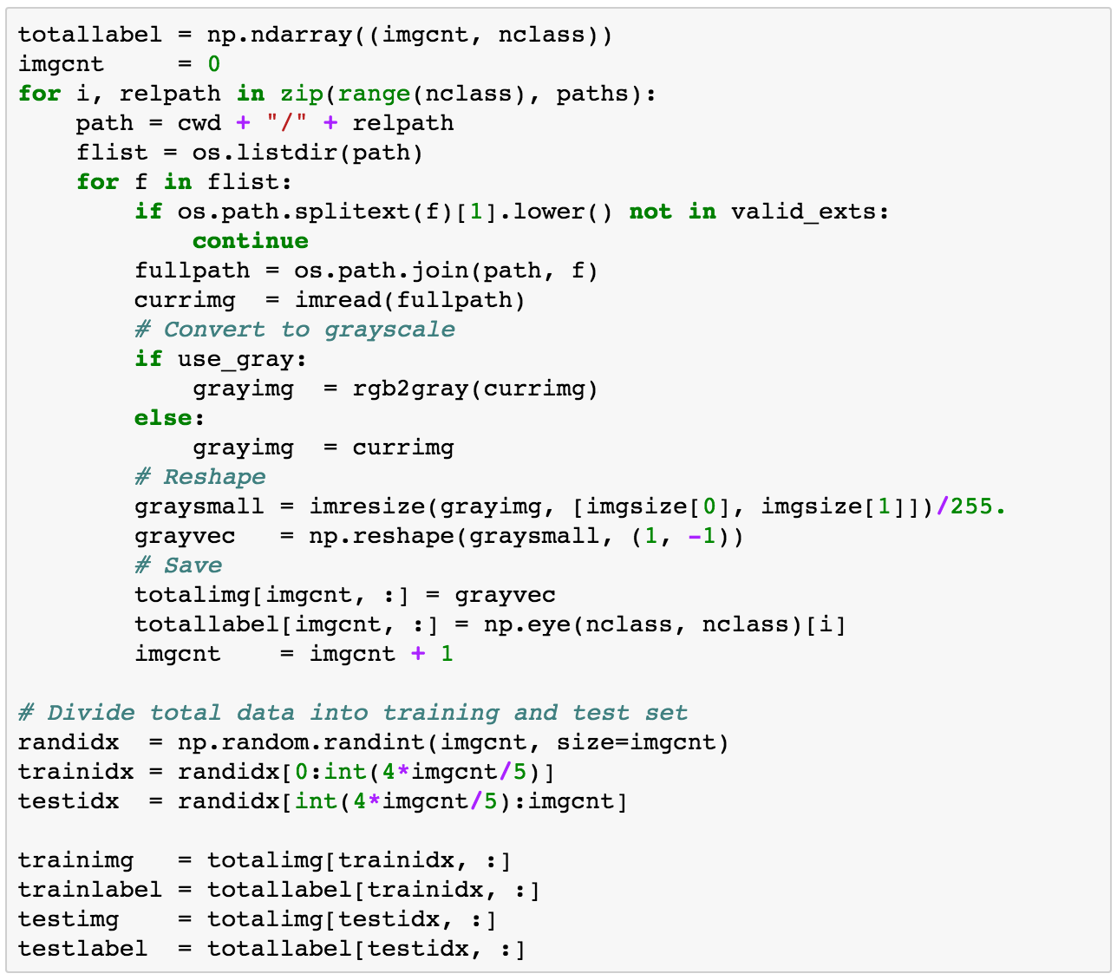
Generating own datasets

Slide 32
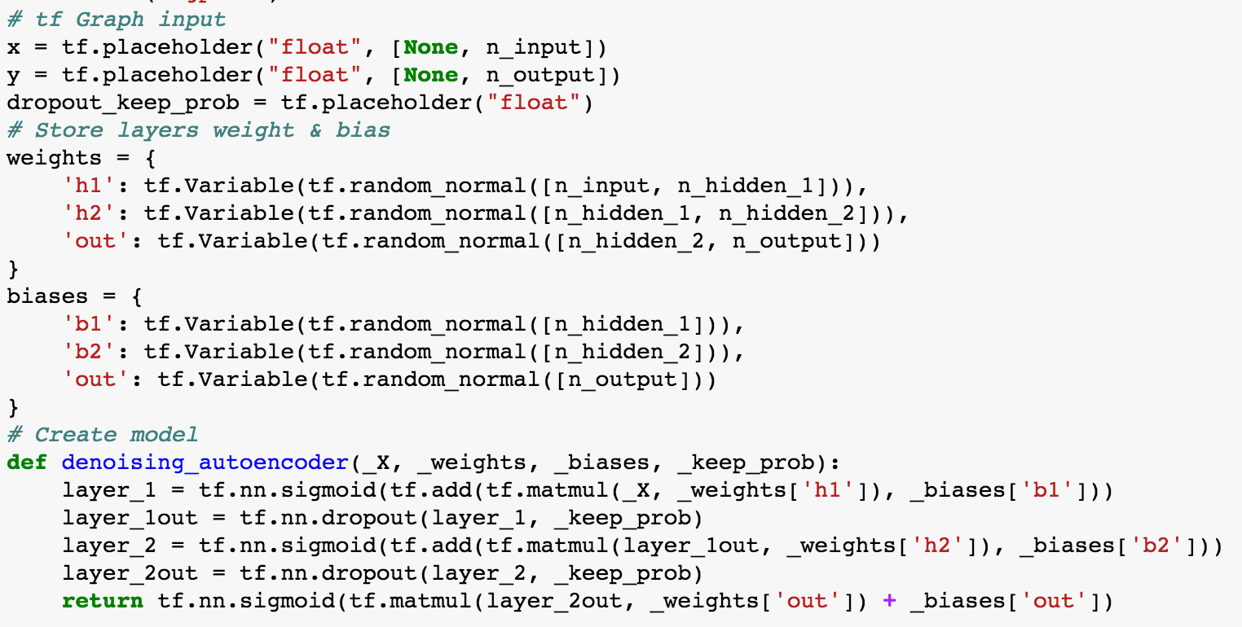
Denoising auto-encoder

Slide 33
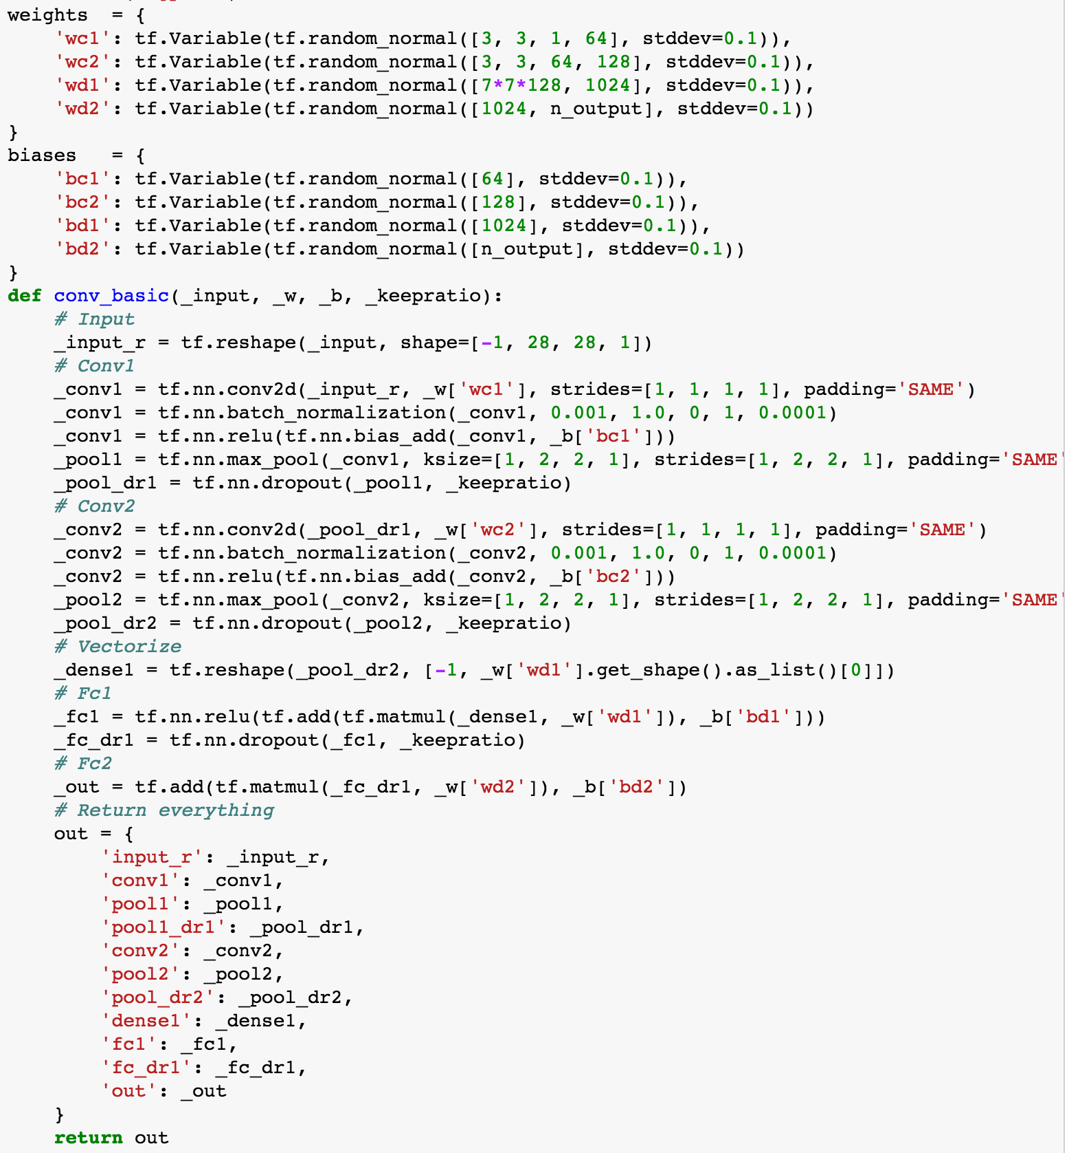
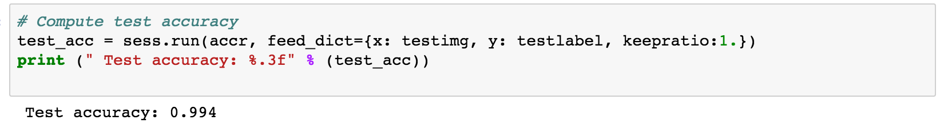
Convolutional neural network

Slide 34
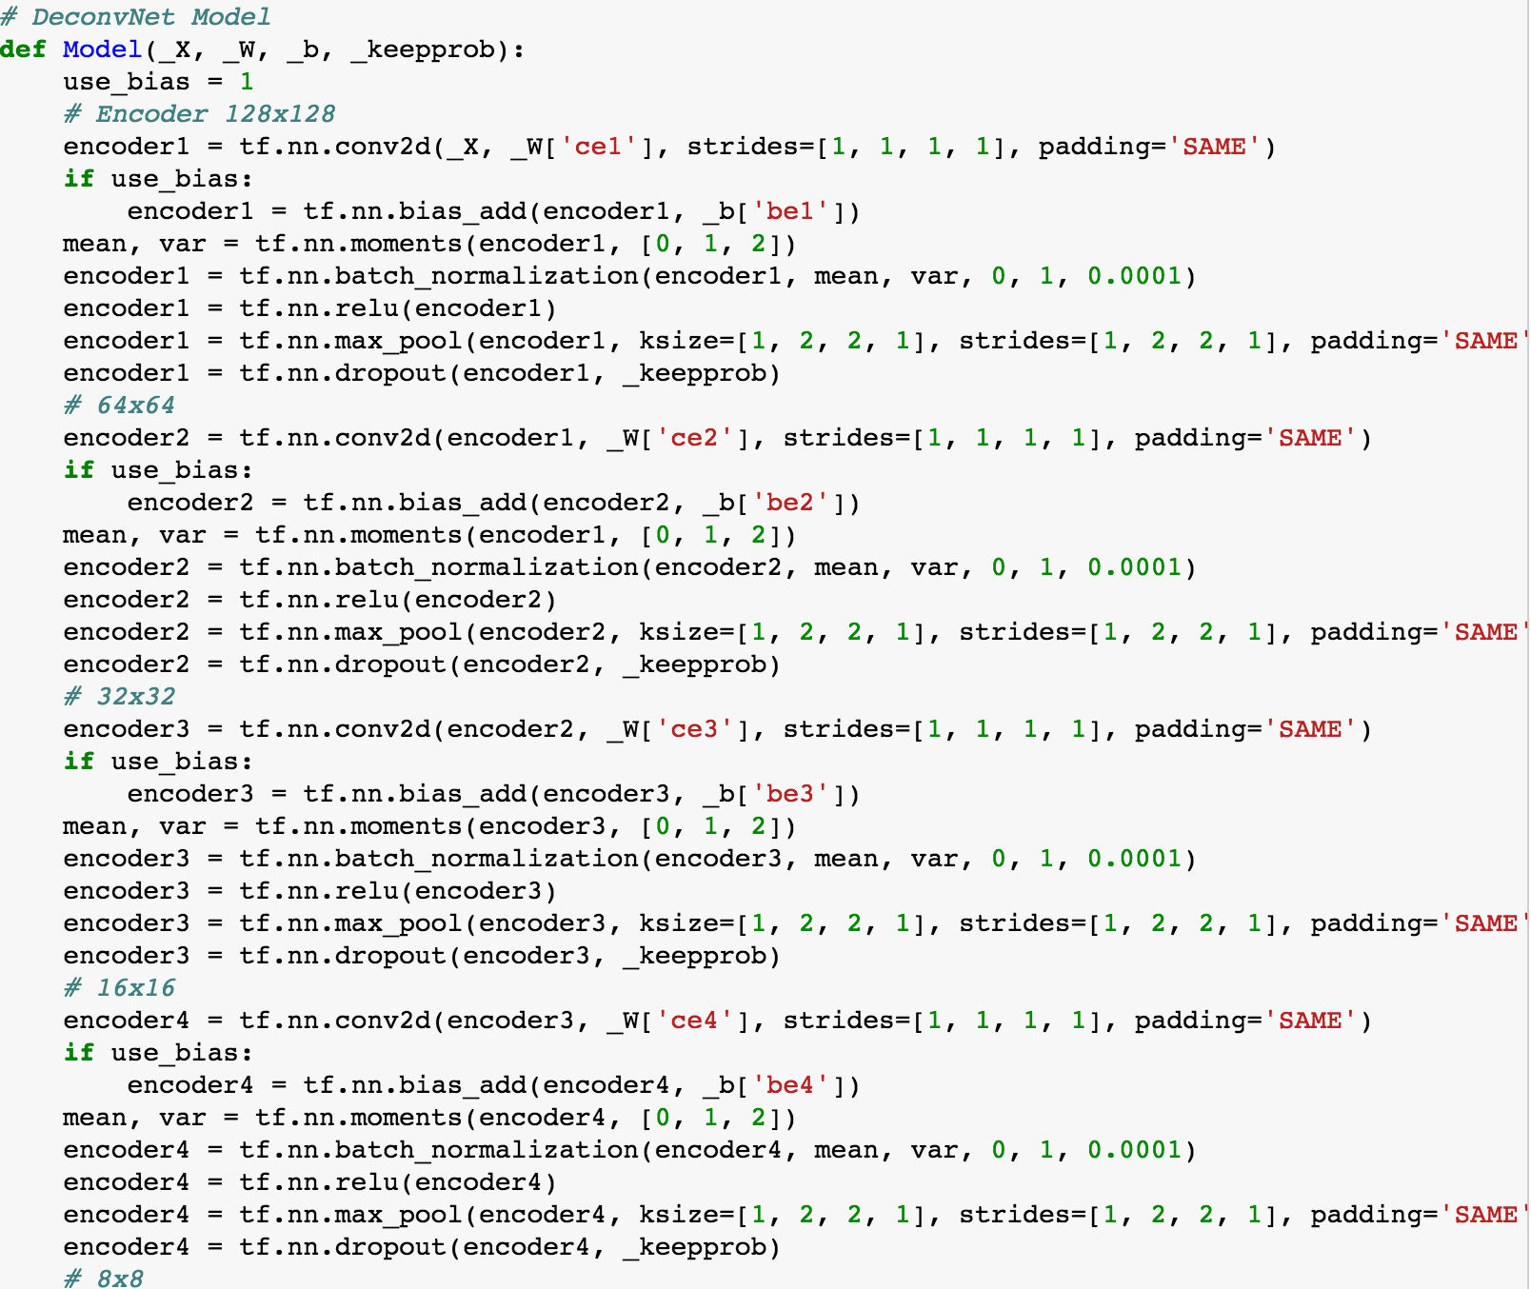
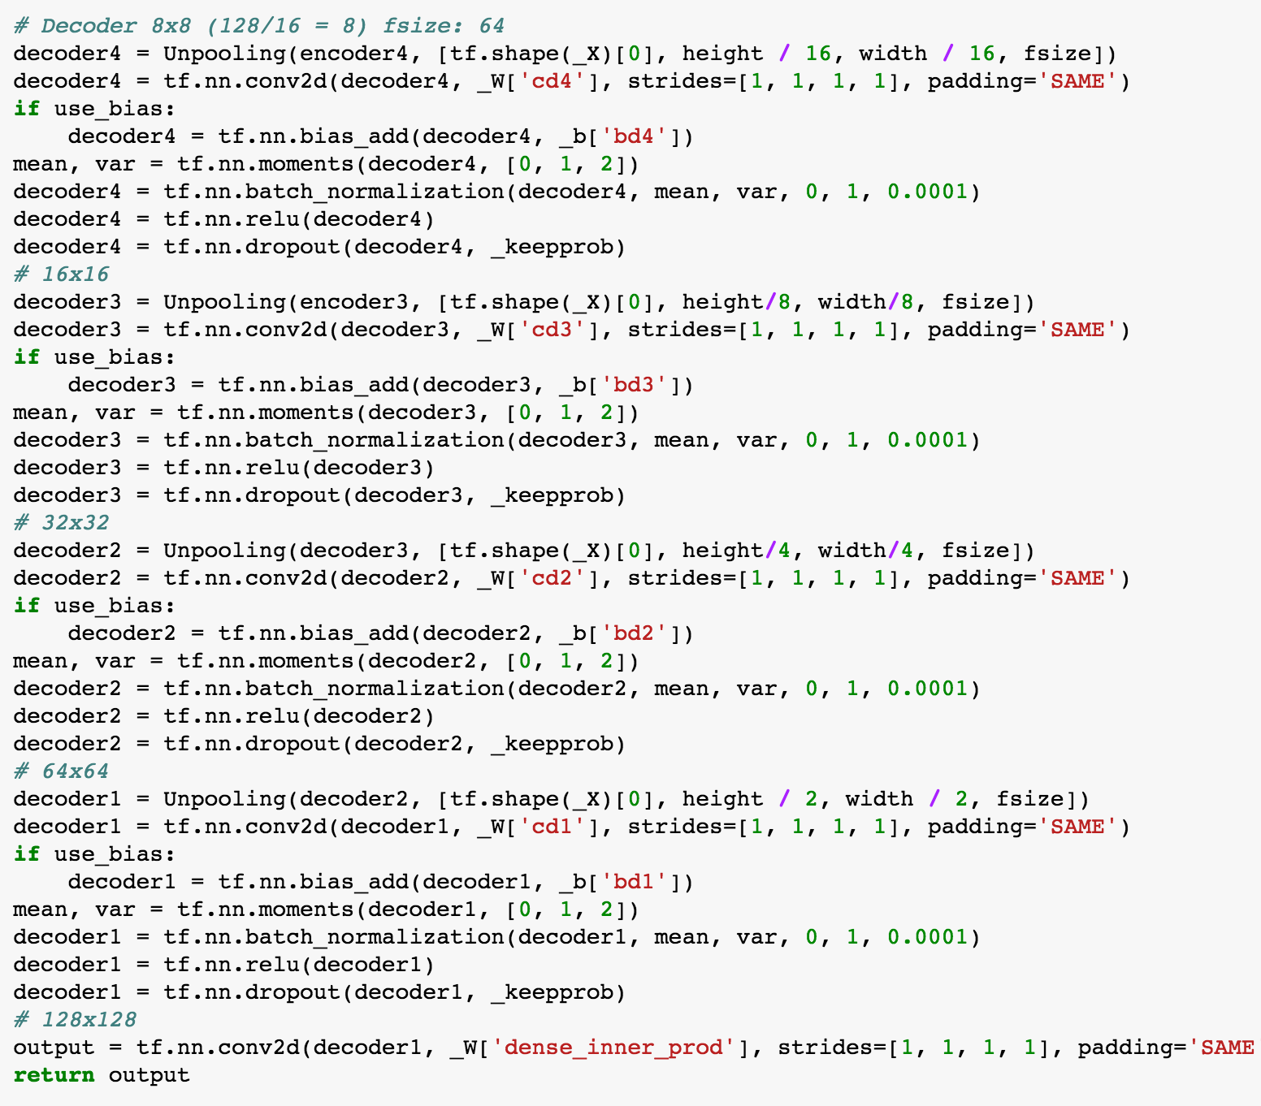
Semantic segmentation

Slide 35
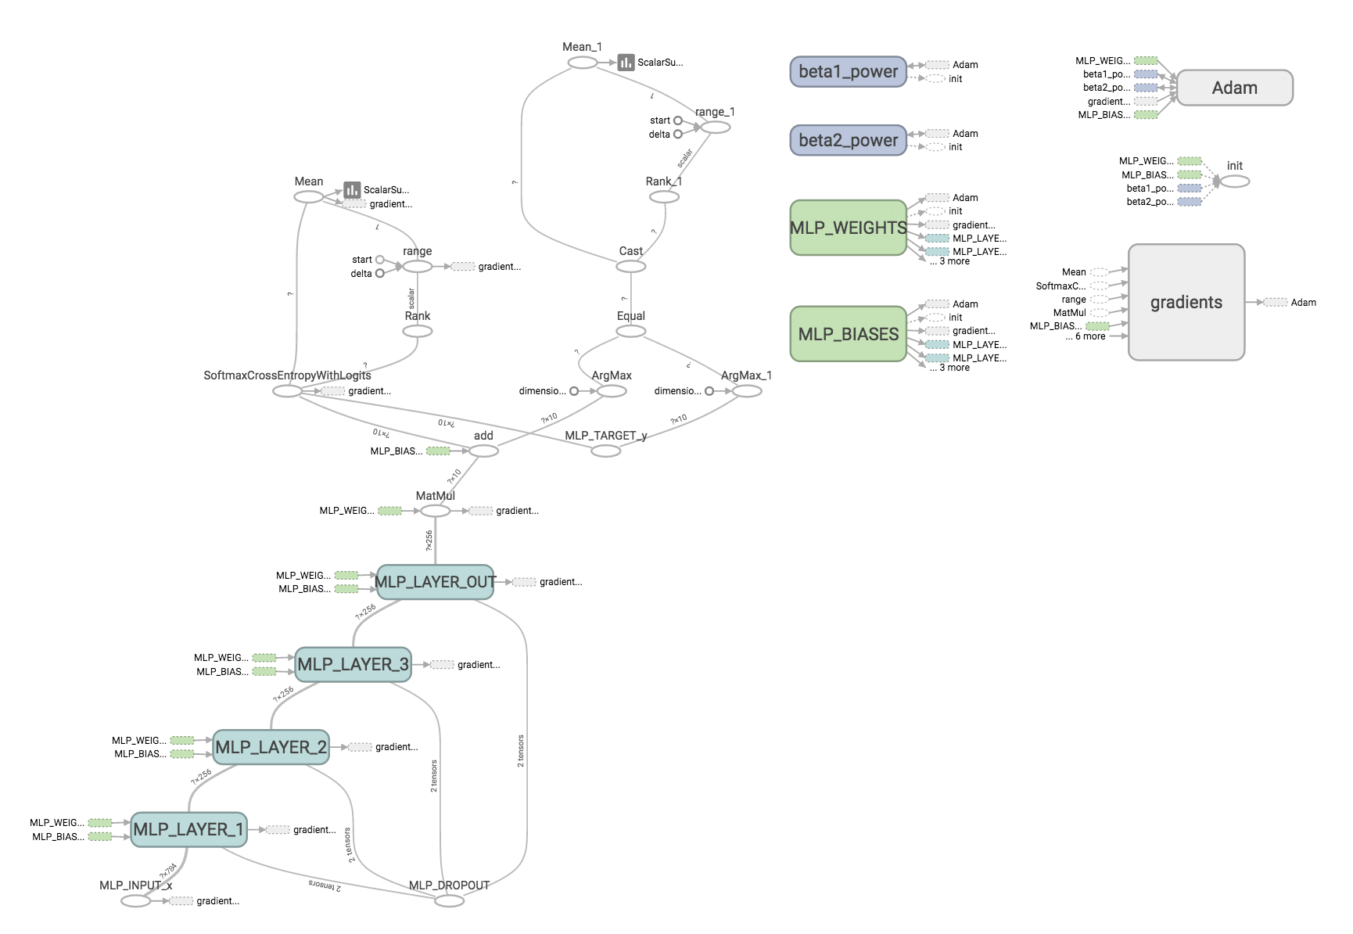
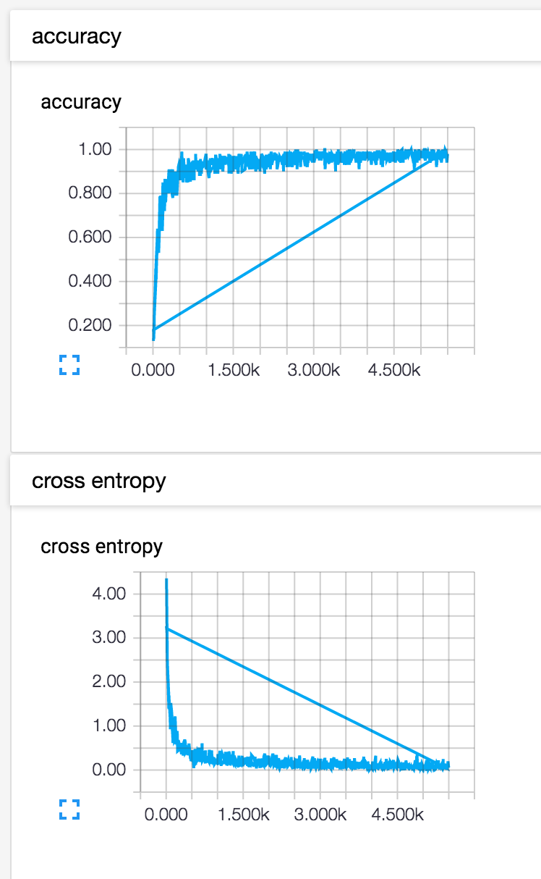
TensorBoard

Slide 36
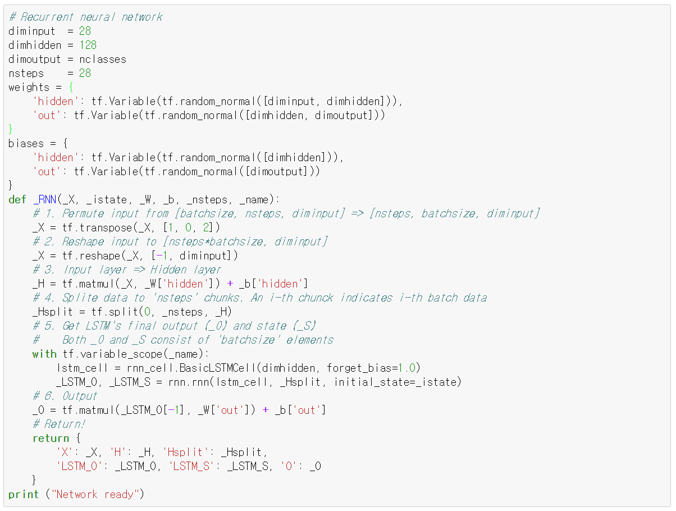
Multi-to-one RNN

Slide 37
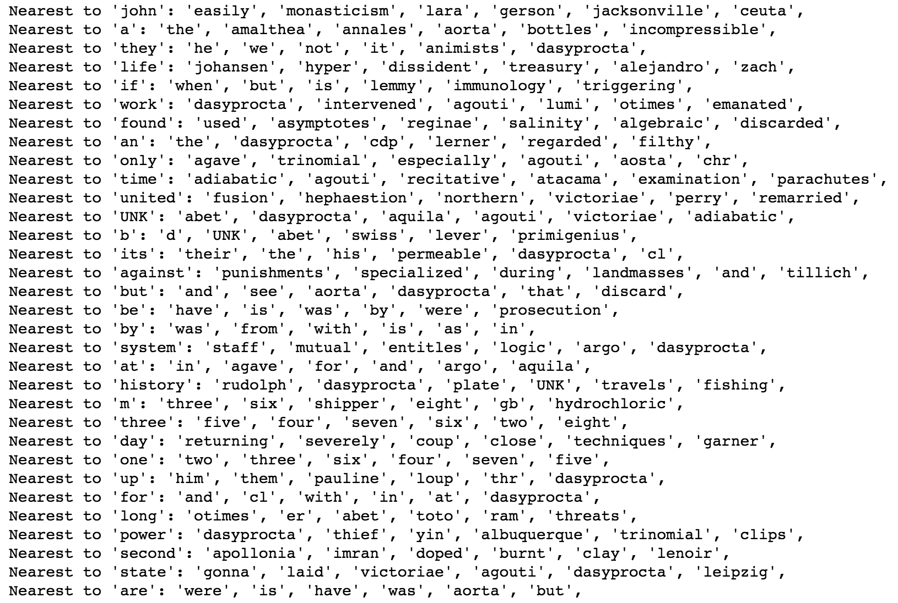
Word2vec

Slide 38

Char-RNN

Slide 39




Neural style

Slide 40
Advanced Topics This is optional.

Slide 41

One-shot learning
2016 One-shot Learning with Memory-Augmented Neural Networks
2016 Matching Networks for One Shot Learning

Slide 42

Domain adaptation
2016 Domain Separation Networks
2016 Domain-Adversarial Training of Neural Networks

Slide 43

Metric learning
2015 DEEP METRIC LEARNING USING TRIPLET NETWORK
2016 Deep Metric Learning via Lifted Structured Feature Embedding

Slide 44

Memory Network
2016 Hybrid computing using a neural network with dynamic external memory

Slide 45

Other interesting papers
2016 Learning without Forgetting
2016 Unsupervised Learning for Physical Interaction through Video Prediction

